Slide 1

Transfer Learning with CNN
1
Reuse knowledge from pre-trained models
2
Accelerate training with limited data
3
Fine-tune ResNet on new dataset
4
Track with W&B: experiments, visualizations, documentation
by Guardians of The Galaxy

Slide 2
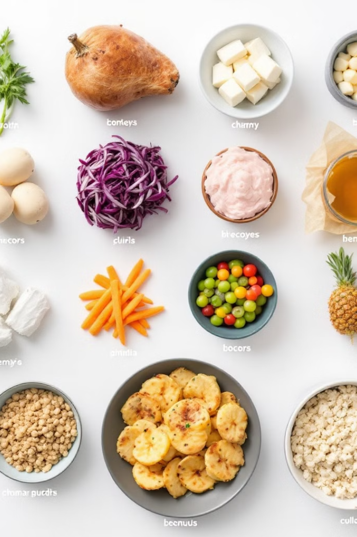
Dataset and Preprocessing Pipeline
Dataset Selection: Food-101 dataset with 15 carefully selected food classes for efficient experimentation
Image Preparation: Resized all images to 224×224 pixels to match ResNet's input requirements
Normalization: Applied standardization with mean/std [0.5] to scale pixel values to [-1,1]
Data Loading: Configured PyTorch DataLoaders with batch size 32 and parallel processing
Reproducibility: Maintained consistency across experiments with fixed random seed (42)

Slide 3
Experimental Tracking with Weights & Biases
Dataset Configuration
Model Architecture
Logged comprehensive dataset details including class names, sizes, and preprocessing parameters to ensure reproducibility.
Tracked ResNet-18 parameters and gradients with wandb.watch() for detailed model performance analysis during training.
Training Metrics
Result Artifacts
Monitored loss, accuracy, and F1-scores for both training and testing phases to evaluate model improvement.
Saved best model checkpoint as W&B artifact with detailed summary metrics and confusion matrix visualization.

Slide 4
Feature Extraction with Pre-trained ResNet
Model Adaptation: Loaded ImageNet-pretrained ResNet-18 and replaced final layer with new 15-class classifier
Feature Freezing: Locked all convolutional layers to preserve powerful ImageNet features
Efficient Transfer: Only trained the new fully-connected layer (512 → 15 neurons)
Key Benefits: Reduced training time, minimized overfitting risk, and leveraged generalized visual patterns
Implementation: GPU-accelerated training with complete model architecture logged to W&B

Slide 5

Hyperparameter Tuning Process
Our systematic hyperparameter optimization explored multiple configurations to maximize model performance on the Food-101 dataset.
Hyperparameter
Options Explored
Optimizer
Adam, AdamW RMSprop, SGD
Learning Rate
0.0001, 0.0003, 0.0005, 0.001
Batch Size
32, 64, 128
Epochs
10, 15, 20
Weight Decay
0 (None), 0.0001, 0.001
Dropout
0.3, 0.5 (for regularization testing)
Loss Function
CrossEntropyLoss, (with and without Label Smoothing)
Each configuration was tracked in W&B with detailed performance metrics for comprehensive comparison.

Slide 6
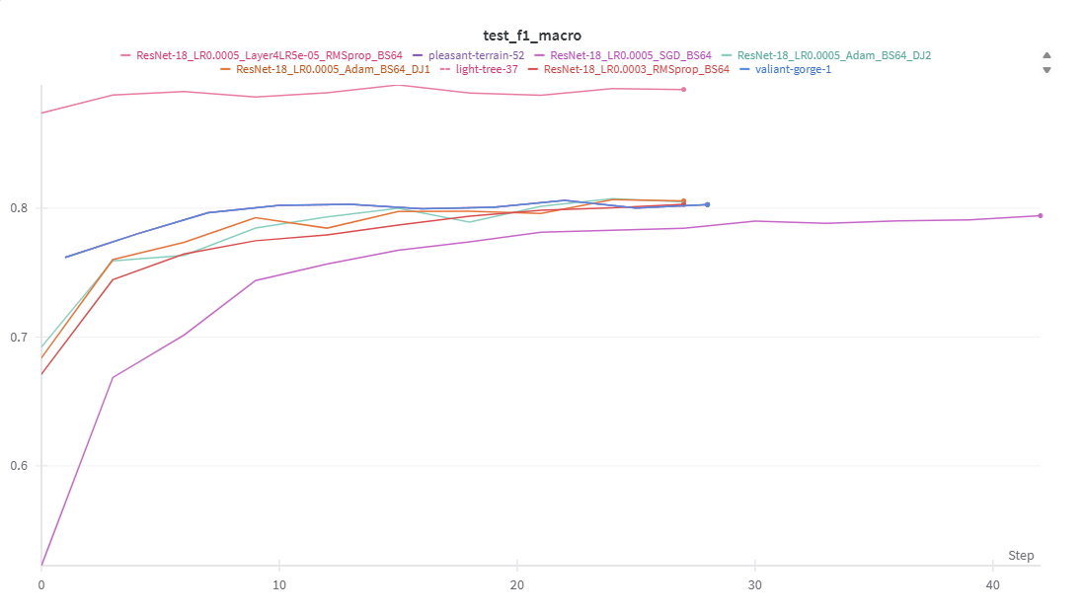
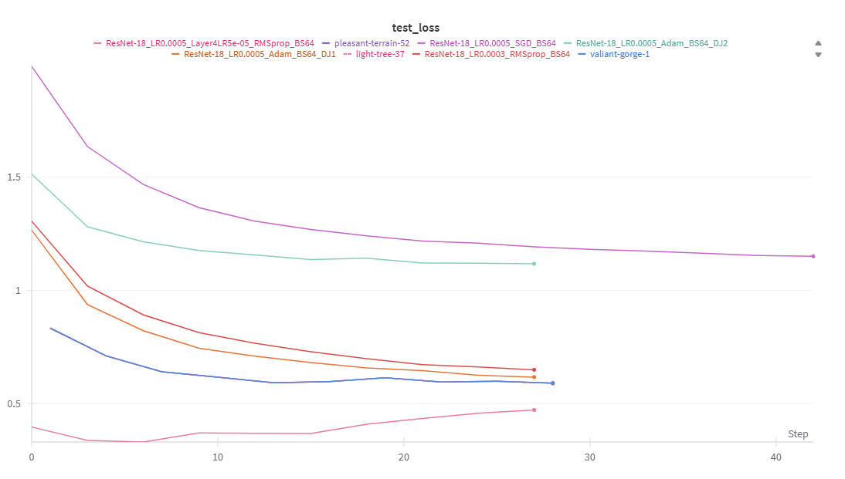
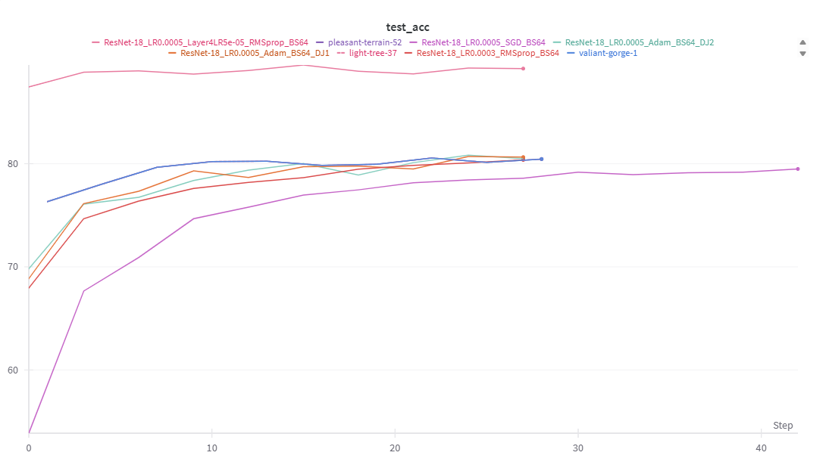
Results
Highest performance:
ResNet-18_LR0.0005_Layer4LR5e-05_RMSprop_BS64, ResNet-18 with Adam (LR=0.0005, batch_size=64)
Accuracy: 89.57%, F1 Score: 0.89 (best), Test Loss: 0.47 (lowest)
Lowest performance:
ResNet-18_LR0.0005_SGD_BS64, ResNet-18 with SGD (LR=0.0005, batch_size=64)
Accuracy: 79.4% (lowest), F1 Score: 0.79, Test Loss: 1.15

Slide 7

Fine-Tuning the ResNet Model
Why Fine-Tune?
Our Fine-Tuning Strategy
Optimized Learning Rates
Feature extraction alone limits adaptation to our Food-101 dataset.
We started with our feature extraction checkpoint.
Applied lower LR (0.0001) for Layer4 to avoid disrupting weights.
Unlocking deeper layers allows the model to refine pre-learned features.
Unfroze only Layer4 (deeper convolutional block) and FC layer.
Used higher LR (0.001) for FC layer to accelerate food-specific learning.
This improves generalization across our 15 food classes.
Earlier layers remained frozen to preserve low-level feature detectors.
Implemented with Adam optimizer using parameter groups.

Slide 8
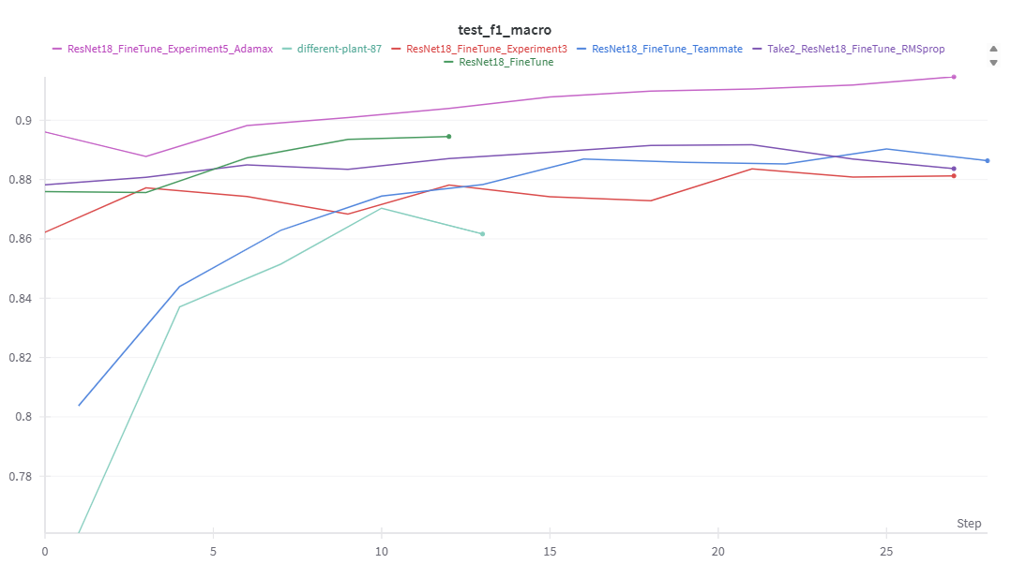
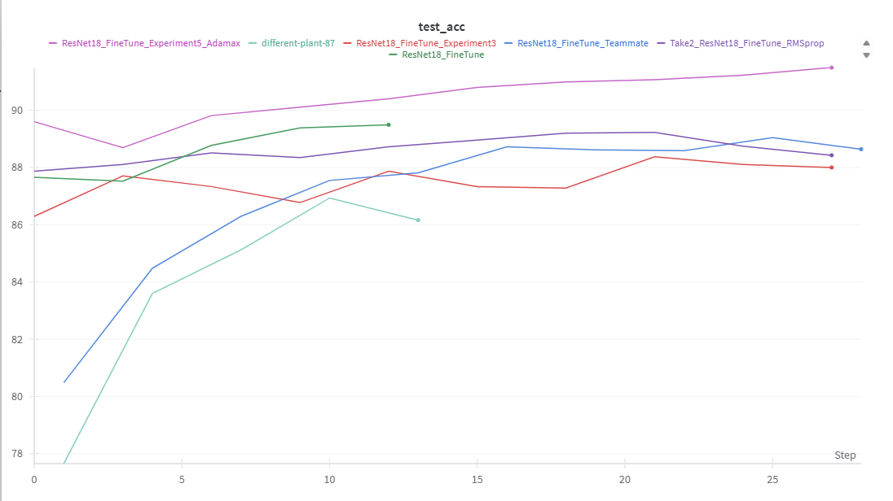
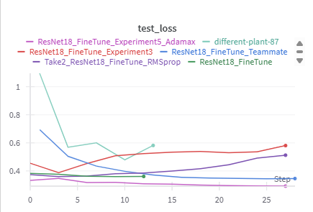
Results
Highest Performance:
ResNet18_FineTune_Experiment5_Adamax
Best Accuracy: 91.49%
Best F1 Score: 0.9146
Best Test Loss: 0.2919
Lowest Performance:
different-plant-87
Lowest Accuracy: 86.16%
Lowest F1 Score: 0.8616
Highest Test Loss: 0.5818

Slide 9
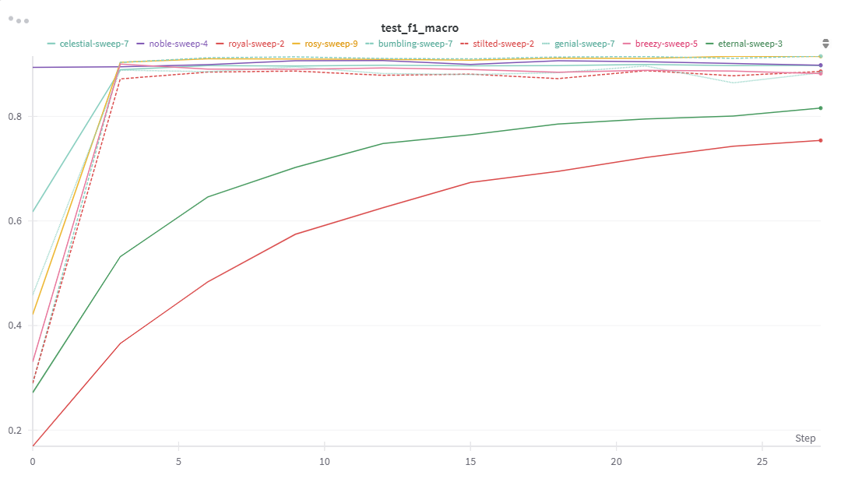
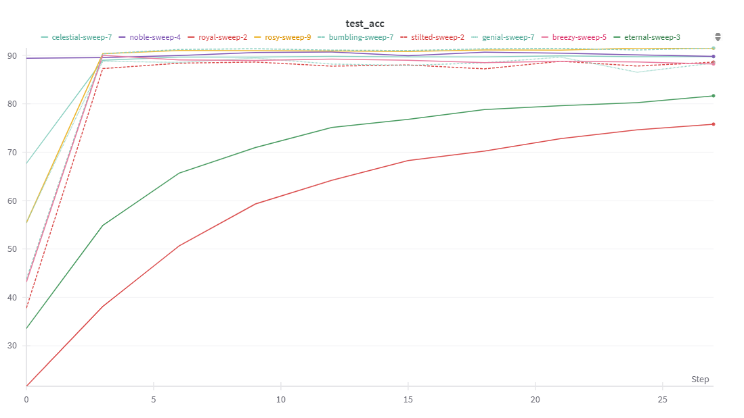
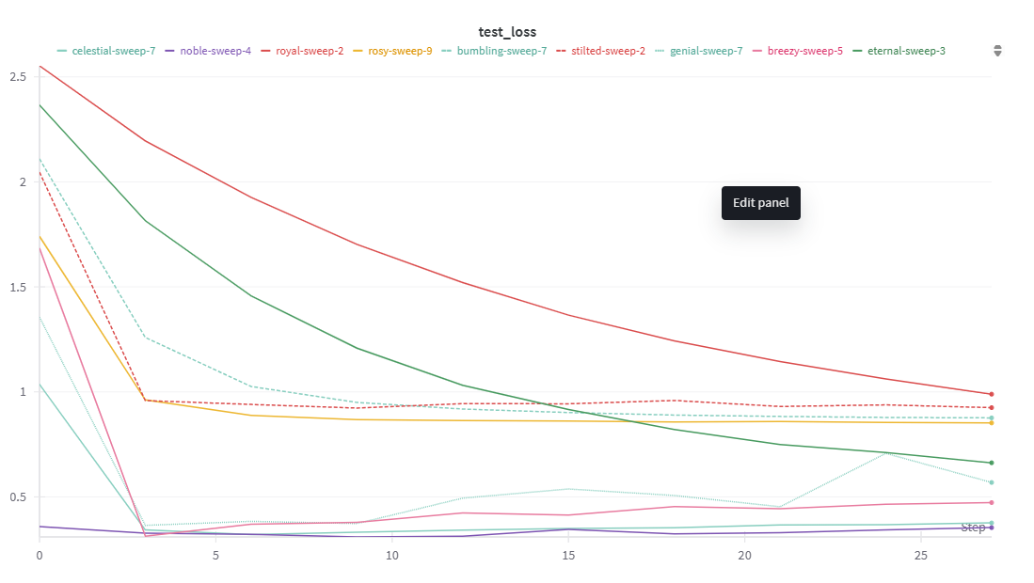
Sweep Results
Best Performance:
Best Accuracy: bumbling-sweep-7 – 91.55%
Best F1 Score: bumbling-sweep-7 – 0.9153
Lowest Test Loss: noble-sweep-4 – 0.3536
Worst Performance:
Lowest Accuracy: royal-sweep-2 – 75.79%
Lowest F1 Score: royal-sweep-2 – 0.7540
Highest Test Loss: stilted-sweep-2 – 0.9249

Slide 10
Impact of Unlocking More Layers 🔓📈
Why It Helped
1
Freezing limited our model to generic ImageNet features. Unfreezing Layer4 and FC allowed learning food-specific patterns.
2
Observed Improvements
Test accuracy and macro F1-scores improved significantly. Class accuracies became more consistent across all food categories.
Key Takeaways
3
Fine-tuning select layers preserved useful pre-trained knowledge while enhancing critical areas. Custom learning rates provided better control.

Slide 11
Model Artifact Logging & Team Collaboration 🤝📦
Artifact Logging in W&B
Collaborative Workflow
Pipeline Benefits
Team members ran parallel experiments
Rapid iteration through shared checkpoints
Stored feature extraction and fine-tuned models as W&B Artifacts
Downloaded and built upon each other's best models
Clear model lineage tracking
Practical experience with enterprise ML workflows
Maintained version history of all model checkpoints
Avoided redundant training cycles
Ensured complete reproducibility of experiments

Slide 12
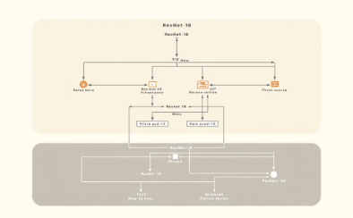



Key Accomplishments
Technical Achievements
Experimental Insights
Collaborative Workflow
Applied Learning
Gained practical experience in managing complete ML lifecycle from dataset preparation to collaborative model refinement.
Implemented ResNet-18 transfer learning on Food-101 dataset with both feature extraction and fine-tuning approaches.
Discovered optimal layer unfreezing patterns and hyperparameter combinations through structured experimentation.
Established efficient team practices using W&B for experiment tracking, artifact logging, and model sharing.

Slide 13
THANK YOU

